Slide 1
Classes & Objects:
Defining a class in Java , Creating objects, Instance variables:
Classes:
A class is a logical structure which contains logic. A class is a conceptual idea. It is an user defined
data type. It exists at logical level. It encapsulates two things – data(variable) and code(methods). A Class is a conceptual logical structure which can be implemented physically through objects.
Objects :
Object is real world entity which has physical existence , which we can touch, feel and can see. Object that we know how to use it but do not know its functionality. All the properties of a class is reflected in the objects. Object is the instance of class.
Instance Variable:
The variables of class are known as instance variable because a new copy of variable is created in memory with every object of a class
1

Slide 2
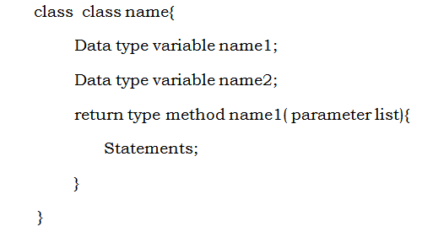
Classes & Objects:
Defining a class in Java , Creating objects, Instance variables:
Defining Class:
Code-1:
Adding Method to class: Code-2:
Methods Accepting Parameters: Code-3
Methods Returning Values: Code-4

Slide 3
Classes & Objects:
Objects as Parameters.
Method accepting Object as a Parameter:
void disp( int num)
void disp( Box b)
The Object of any class can be treated as variable and its datatype is class. Hence, we can write methods accepting as well as returning objects.
Code-11
Method Returning Objects:
int disp()
float disp()
box disp() // disp() returns object of Box class.
Code-12

Slide 4
Classes & Objects:
“this” keyword:
When local variable name of method is conflicted with the instance variable name of the class, method does not recognize the instance variable. This is known as instance variable hiding. But method can refer instance variable by using “ this “ keyword with (.) dot operator.
The “this” keyword represents the current object. It is used to call a constructor from constructor.
Now the local variable name and instance variable name can be resolved using “ this ‘ keyword. Constructor created are also the part of object and memory actually gets allocated to the constructor even this can be provided by “ this” pointer.
Code-5

Slide 5
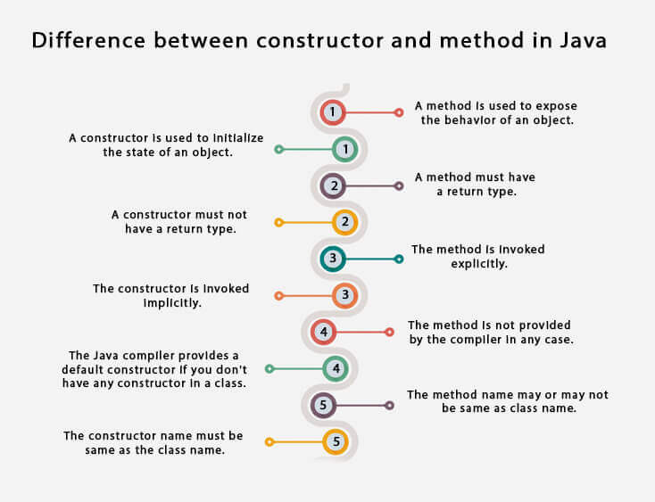
Classes & Objects:
Constructor Vs Method

Slide 6
Classes & Objects:
Constructor:
Constructors are as good as methods. Constructors are normally used to assign values to the set of instance variables. They are called implicitly at the time of creation of object and can’t be called explicitly. They have same name as that of class. They don’t have return type.
Once we creates an objects , compulsory we should perform initialization then only the object is in position to respond properly.
The role of Constructor is to perform initialization of an object. The Modifiers applicable to constructor s are public, private, protected and default.
1. Default Constructor: A Constructor which does not accept any value(no argument). It is generated by compiler. If we are not writing any constructor then only compiler will generate default constructor. i.e. if we are writing at least one constructor then compiler won't generate default constructor.
The access modifier for default constructor is exactly same as access modifier of class.( This rule is only applicable for public and default).
Code-6
2. Parameterized Constructor: A Constructor which accepts some argument.
Code-7

Slide 7
Classes & Objects:
Use of toString() method of Object class.
The toString() method returns the string representation of the object.
By overriding the toString() method of the Object class, we can return values of the object.
toString() is the method of Object class. This method returns a string representation of the object,
which contains the description of object. It is used to print the description of any object while calling with object
Syntax:
public String toString() :
Code-10

Slide 8
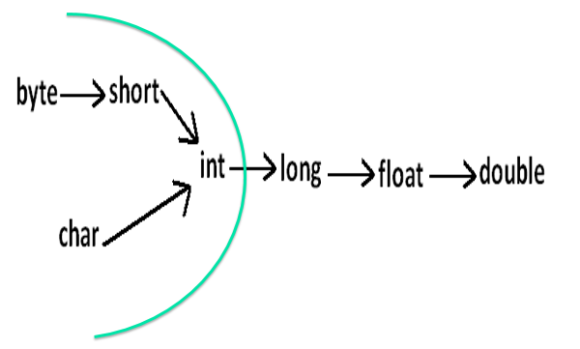
Classes & Objects:
Methods Overloading:
When a class contains multiple methods sharing the same name but having different parameter structure it becomes method overloading. Java faces a multiple version of methods in memory and chooses proper version depending on parameter passed to the method. Return type does not play any role in method overloading.
Automatic promotion in overloading: While resolving overloaded methods if exact matched method is not available then we wont get any compile time error immediately. First it will promote argument to the next level and check whether matched method is available or not. If matched method is available then it will be considered . If the matched method is not available then compiler promotes argument once again to the next level. This process will be continued until all possible promotions still if the matched method is not available then we will get compile time error. While resolving overloaded methods compiler will always gives the precedence for child type argument when compared with parent type argument.
Code-8
Constructor Overloading:
When a class contains multiple constructors which has different parameter structure, it becomes constructor overloading. Java chooses proper version of constructor depending on the parameter passed to constructor.
Code-9

Slide 9
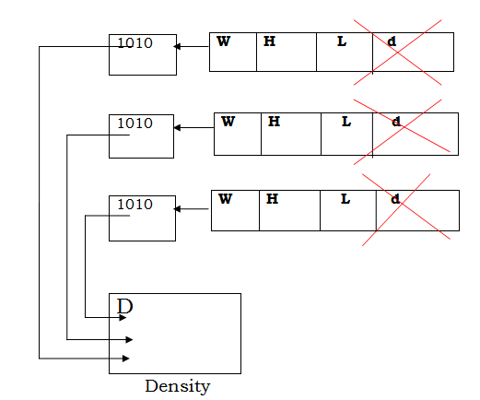
Classes & Objects:
static keyword :
The static members of a class are loaded in memory when class loads in memory. It means that they are loaded in memory when that class is referred for the first time during runtime. It means that the static members of class are loaded in memory before creation of object of that class. Hence static members can be referred by using class name with dot(.) Operator.
Static members are loaded in memory before creation of any object of that class, hence it can be accessed directly with class name and dot (.)Operator.
They cannot refer to this or super in any way. It is illegal to refer to any instance variable inside of static method. The static methods can refer static members only.
Code- 13

Slide 10
Classes & Objects:
Initializer blocks
Instance Initializer block is used to initialize the instance data member.
It run each time when object of the class is created.
Initialization blocks are executed whenever the class is initialized and before constructors are invoked.
They are typically placed above the constructors within braces.
There are two types of initialization blocks:
-----instance initialization blocks, and
-----static initialization blocks.
Code-14:

Slide 11
Classes & Objects:
Garbage collection and finalize method:
Garbage Collection is the mechanism for deallocation of memory automatically when object goes out of scope.
When no references to an object to an object exist, that object is assumed to be no longer needed, and the memory occupied by the object can be reclaimed(destroyed).
The finalize () Method:
Sometimes an object will need to perform some action before it is destroyed. To handle such situations, java provides a mechanism called finalization. By using finalization, you can define specific actions that will occur when an object is just about to be destroyed by the garbage collector.
Inside the finalize() method we will specify those actions that must be performed before an object is destroyed.
The finalize() method Syntax:
protected void finalize() { // finalization code here }
Here, the keyword protected is a specifier that prevents access to finalize() by code defined outside its class.
Code15:

Slide 12
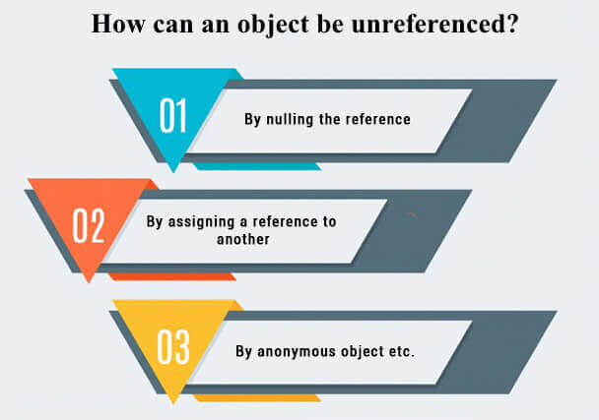
Classes & Objects:
Garbage collection and finalize method:

Slide 13
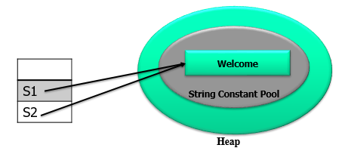
Classes & Objects:
String Class:
String manipulation is the most common operation performed in Java programs. The easiest way to represent a String (a sequence of characters) is by using an array of characters. A String represents group of characters. Strings are represented as String objects in java.
String is immutable object (once created cannot be modified).
The object created as a String is stored in the Constant String Pool.
String is not thread safe, means it can be used by two threads simultaneously.
String objects are stored in a special memory area known as constant pool.
String s1="Welcome";
String s2="Welcome"; //will not create new instance

Slide 14
Classes & Objects:
String Class:
String demo = "KK" ;
// The above object is stored in constant string pool and its value cannot be modified.
demo="PK" ; //new "PK" string is created in constant pool and referenced by the demo variable.
// "KK" string still exists in string constant pool and its value is not overridden but we lost reference to the "KK" string.
Creating Strings:
We can declare a String variable and directly store a String literal using assignment operator.
String str = “Krishna";
We can create String object using new operator with some data.
String s1 = new String ("Java");
We can create a String by using character array also.
char arr[] = { 'p','r','o',’g’,’r’,’a’,’m’};
We can create a String by passing array name and specifying which characters we need:
String s3 = new String (str, 2, 3);
Here starting from 2nd character a total of 3 characters are copied into String s3.

Slide 15
Classes & Objects:
Constructor of String class:
String str = new String();// Default
String str1= “abc”;
String str2=new String(str1);
S.O.P(str2);
O/P: abc
Methods of String class:
String str1= “Click”;
String str2= “Hello”;
String str3= “Hi”;
String str4= “Hi”;
1. length():
int length();
S.O.P(str1.length());
O/P: 5
2. charAt():
char charAt(int index)
S.O.P(str1.charAt(2);
O/P: i

Slide 16
Classes & Objects:
String Class:
Methods of String class:
3. subString():
String substring(int startindex, int endindex)
S.O.P(str1.subString(1,4); // click
O/P: lic
4. equals():
boolean equals(String str)
S.O.P(str3.equals(str4);
O/P: true
5. compareTo(): It compares strings on the basis of Unicode value of each character in the strings.
int compareTo(String str)
S.O.P(str3.compareTo(str1);
O/P: -1
int compareTo(String str)
S.O.P(str1.compareTo(str3);
O/P: 1
int compareTo(String str)
S.O.P(str3.compareTo(str4);
O/P: 0

Slide 17
Classes & Objects:
String Class:
Methods of String class:
6. replace():
String replace(char oldchar, char newchar)
S.O.P(str2.replace(‘l’ , ‘p’);
O/P: Heppo
7. toUpperCase():
String toUpperCase()
S.O.P(str1.toUpperCase());
O/P: CLICK
8. toLowerCase();
String toLowerCase()
S.O.P(str1.toLowerCase());
O/P: click
Code-16:

